Slide 1
Tree
Il-Chul Moon Dept. of Industrial and Systems Engineering KAIST
icmoon@kaist.ac.kr
Notes:
This week, we’ll be looking at the concept of a tree.

Slide 2
Weekly Objectives
This week, we study the tree data structure. Particularly, we will focus on the structure and the operation of the binary search tree.
Objectives are
Memorizing the definitions, the terminologies and the characteristics of trees
Understanding the structures of trees
Understanding the structure and the operations of a binary search tree
Insert, search, delete operations
Tree traversing operations
Depth first search
In-order, post-order, pre-order sequences
Breadth first search
Level order search
Understanding the performance of binary search tree
Notes:
To understand a tree, we have to do the following:
First, we’ve got to define various tree structures.
In the case of a linked list, though, it differs in structure from an array. Its nodes are linearly connected, but the functional aspect differs.
A tree is completely different from an array, so we have to learn about its various terms and characteristics.
We have to understand the basic structure of the data structures and their operations.
There are a range of tree structures.
What we are going to cover this time is a binary search tree or BST.
Aside from the binary search tree, there are many more tree types available.
We have B-tree, AVL-tree, and Red Black tree, to name a few. Our objective is to learn about the basic characteristics of trees. We will narrow the topic to cover a binary search tree. Later, we’ll learn about what is a binary heap.
While it would be interesting to learn about various types of trees, it’s rarely necessary to implement them in reality.
So, we will place more emphasis on the practical aspects of trees by learning their primary characteristics and what types of operations they support.
Trees are characterized by some specific operations.
That’s what is called traversing.
To achieve our weekly objective, we have to first understand what a tree is.

Slide 3
Detour: Abstract Data Types
An abstract data type (ADT) is an abstraction of a data structure
An ADT specifies:
Data stored
Operations on the data
Error conditions associated with operations
Example: ADT modeling a simple stock trading system
The data stored are buy/sell orders
The operations supported are
order buy(stock, shares, price)
order sell(stock, shares, price)
void cancel(order)
Error conditions:
Buy/sell a nonexistent stock
Cancel a nonexistent order
Operations
Data Stored
Notes:
Let’s recap a bit.
We’ve learned about abstract data types.
A typical example of a good abstract data type is attained by defining what types of data are stored and which operations and error conditions are available.
So, a tree falls into the category of abstract data types.

Slide 4

Tree as an abstract data type
Tree structure
Abstract data type
Data stored
As a tree structure
Operations
Ordinary data structure operations just as linked lists
Insert
Delete
Search
Special searching approaches for trees and networks
Traverse
Notes:
Now, we’re going to explore the structure of the tree, an abstract data type.
What type of tree it is?
This looks just like an ordinary tree you can find anywhere.
One notable point is that it is upside-down.
The figure takes an upside-down form.
In the field of computer science, especially data structure, the typical form of a tree takes an upside-down shape. The roots are located above, and the branches and leaves are below.
In a computer, it can be expressed like below.
This tree has roots, with the bottom part above instead. Various branches spread from the stump, and leaves grow from the branches.
A tree structure is a type of abstract data type that’s used to store data.
The operations of a tree structure include those supported by basic data structures.
For instance, what types of operations did we see in a linked list?
To briefly review that topic, we were able to insert data with a linked list.
By insert, we were able to cut the connection here and add a new node.
It was possible to conduct a search for 4 nodes in this order.
If we were to remove it, we just had to add a new connection to this node and sever the connection here.
A linked list supports insert, delete, and search.
These things should be supported in a tree.
However, a tree has a peculiar structure.
For instance, it can issue a command like this.
When we arrange all the content in the linked list, the values of 1, 2, 3 will be printed out for this part, which is disconnected.
In other words, it’s a form of traversing that lists up all the data.
However, there is no need to learn traversing for a linked list. That’s because it finds and arranges items, one by one.
Does this also hold true for a tree?
If it is like this, we would put it out to find No. 2 and No. 3 below. Again, No. 4, No. 5, No. 6, and No. 7 are underneath.
Since it doesn’t have the linear structure of a linked list, drawing each data may lead to the generation of many variations.
The point is that traversing may be defined in a range of ways.
Thus, we will cover various forms of traversing to define various tree structures.

Slide 5


Why do we use trees?
Because the structure of trees is a good analogy to the various real world structures
Corporate structures
Group bank accounts
Command and control structures
Why is the structure one of the most favorite structures?
A clear approach of Divide and Conquer
Notes:
Why do we use a tree structure, then?
Let’s just take a moment to think about it.
Tree structures like this can be observed in reality.
For instance, it could be an organization chart or the group bank account of a company.
While ordinary people would see the list to which their accounts belong by logging in with their names, there are some cases in which a certain account has a sub-account in it or in another account.
If it is the same firm, it could have a systemic bank account like that.
Also, there are organization charts, position systems, etc.
Is there a certain concept that unites them all?
Yes, it’s the same concept that we’ve learned when we dealt with recursion and dynamic programming.
That is “divide and conquer.”
For example, the tree structure makes use of a method that allows us to follow the tree structure to solve problems. It divides and stores different branches for each branch. Also, each branch holds a specific type of data that can be different from another.
A tree structure can be considered a model of the “divide and conquer” principle.
As we reduced the scale of the problem by adopting a top-down approach in a recursion, the tree structure also relies heavily on a recursion structure.

Slide 6
Structure of stored data
Linked List
Object
N e x t
Object
N e x t
Object
N e x t
Object
N e x t
Head
Tail
Tree
Nothing but with multiple ‘next’s
Each node has multiple next nodes
Particularly, this structure maintains the next nodes as an array or variables
Notes:
Let’s examine how data is stored in a tree structure.
As previously observed, a linked list defines a node by locating “object next,” which is next to another “object next.”
The head and tail are special nodes, while a node consists of two member variables: a reference to store an object and another reference to specify what is the next node.
The arrow here serves to store the next node reference.
Then, the object contains the actual values.
As this is a head, it does not hold any specific value.
It is the same linked list, so let me draw it like that.
These are the nexts.
As you see here, it is somewhat similar to this tree structure, but there are differences.
Let’s suppose that this is a single node.
Let’s say this is the node of a linked list and that is a tree node.
This is a tree node. This over here is the part that makes it special.
Previously, there was only a single next in this part that is supposed to accommodate the “next.”
Here, we have a total of 4 nexts.
Similarly, there is one next in a linked list here.
In the case of this tree node, it has four consecutive nodes.
Thus, the top node could have four next nodes, and the next nodes could have four next nodes.
There is only one top node.
Below, it can have a total of four nodes.
Then, the layer below could have a total of 16 nodes.
The rule found in the tree is 4⁰, 4¹, and 4².
Likewise, there are nodes of 1⁰, 1¹ and 1² in a linear form
As the base is 4, it won’t be categorially 1. Instead, it will get raised to the power of 4.
So, it can store a significantly larger space.
Its shortcoming is revealed in the search process: as there are four nexts, we need to figure out which next should be selected.
To be able to manage a tree, we need to establish some clear rules for it.

Slide 7
Terminologies of tree structure (1)
Tree
Root
A
Edge
Node
Internal Nodes
B
C
D
Siblings
A is D’s Parent
D is A’s Child
E
F
G
H
Leaves, Terminal Nodes
Notes:
Now we’ve learned about the basic concept of a tree.
As the tree is a newly introduced concept, we’ll go over some related terms that will prove useful.
This is a tree that features an exponentially increasing number of nodes due to having multiple nexts from a single node, as shown here.
In the tree structure, a node is what is pointed by a single next. This arrow here is called an edge.
This particular node at the top of the tree is specifically called a root.
It is similar to the way the head and tail are determined in a linked list.
In one class called “tree”, as long as we know the root, we can always store data in the structure by using “search”, “insert”, and “delete”.
We can generate a special node called “root”.
A and D are connected by the edge. A is the parent of D, so D becomes the child of A.
This term is used when the node is directly connected.
This is an analogy that we can think of in our daily lives.
We’re going to refer to the collection of children that share the same parent as siblings.
As the parent of E, F, G, and H is B, which means that they form the multiple nexts of B, we are going to call them siblings.
In the tree structure, there are some cases when one node no longer has another next.
The nexts of these nodes contain garbage values.
In other words, the ones at the bottom layer do not have any path that you can search any deeper.
That’s because they don’t have any tree nodes to be pointed by other nexts.
So, we call E, F, G, H, C, and D at the bottom layer the leaves of a tree.
They are also known as terminal nodes.
In this context, nodes other than the leaves of a tree are referred to as internal nodes as they are present inside this tree.

Slide 8
Terminologies of tree structure (2)
Path to E
A
Ancestors of E
Descendants of A
B
C
D
E
F
G
H
Notes:
When we refer to the descendants of A, we’re talking about all the children of A and the children of A’s children.
If we trace upward, past the immediate parents such as B, C, D, E, F, G, and H, we will finally meet A.
We will call the forefathers of E, E’s ancestors.
Although E has only one parent, B, its ancestors include B and A.
H has the same ancestors.
C has only one ancestor, A.
Now we are able to define the path.
Now, the concept of a path is very important.
The path refers to the route that ensures the shortest edges from the location of the root to a specific node.
The path of E will always start from root A. It then goes through A and B, which is the shortest path available to get to E, and then reaches E.
This is called the path of E.
It goes from A to B and B to E.
The length of the path for the node E is 2.

Slide 9
Terminologies of tree structure (3)
Size of tree
A
Depth and level of B
B
C
D
Height of tree
E
F
G
H
Degree of B
Notes:
After defining what is a path, we are now able to define what is a depth or level.
The length of the path to reach the node B is 1.
So, the depth of B is 1.
The depth of A is 0.
Also, the depth of E is 2.
To sum up, the depth of a specific node is the length of the path to the node.
Now, how can we decide the height of a tree?
The height of a tree is equivalent to the maximum path length.
The length of the longest path is the path to reach E or F, G, and H, which is then 2.
So, the height of the tree is 2.
We can also determine what is a degree.
A degree refers to the number of nexts that a certain node can have. The degree of B is 4.
The size of the tree is defined by the number of nodes on the tree.
It can also be the number of the stored nodes.
In this case, the size of a tree is 8.

Slide 10
Terminologies of tree structure (4)
Full Tree
Complete Tree
A
A
B
C
B
C
Full tree
D
E
F
G
D
E
Filled from left
Notes:
Finally, let’s review the overall shape of a tree.
Although there trees generally come in various shapes, there are also trees of special forms.
The leaves of the tree here are located at the same level. For the internal nodes, all nexts here point to the next nodes.
The internal nodes have full next nodes, while the terminal nodes have no next nodes.
A tree with a triangle shape is called a full tree.
The height of the tree is 2 and its degree is 2. That means there is no more space to store data.
To add one more, we have to increase the depth.
That is called a full tree.
Although different from a full tree, another tree that deserves our attention is a complete tree.
A complete tree has a full tree structure till one depth just before.
This is a full tree. The tree with a structure of nodes filled up from the far left to right is called a complete tree.
In other words, the above is a full tree. It is a complete tree if each node is filled from the left side.
For instance, if there is one additional node here by the next reference of C, it is not a complete tree.
That’s because the node is not attached to the left-hand side of C, but the right-hand side.
On the other hand, if a node is attached to the left-hand side, rather than right-hand side, it is a complete tree. That’s because its nodes are in the process of being filled up from the left side.
Therefore, we could discern the shape of a tree between full tree and complete tree based on their branches.

Slide 11
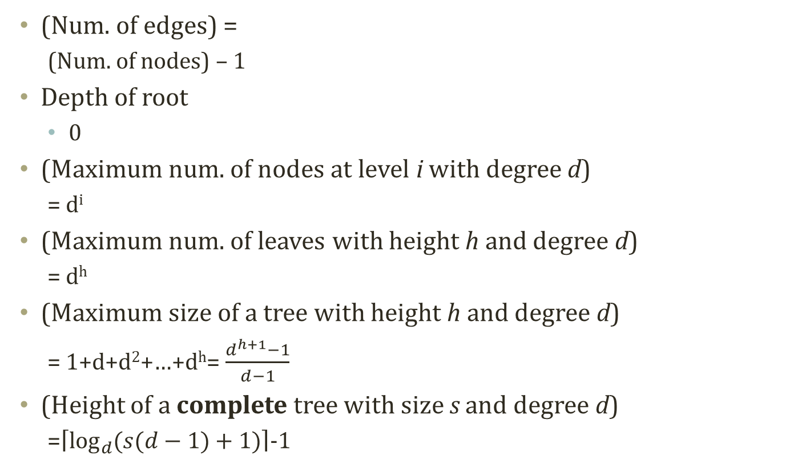
Characteristics of trees
A
(Num. of edges) =
(Num. of nodes) – 1
Depth of root
0
(Maximum num. of nodes at level i with degree d)
= d^{i}
(Maximum num. of leaves with height h and degree d)
= d^{h}
(Maximum size of a tree with height h and degree d)
= 1+d+d²+…+d^{h}= $\frac{d^{h+1}−1}{d−1}$
(Height of a complete tree with size s and degree d)
=$\left\lceil \log_{d}{(s(d−1)+1)}\right\rceil$-1
D
B
C
E
F
G
H
Notes:
Now that we’ve covered various names for trees, it’s time to move on to its numerically defined characteristics.
How many edges does it have here?
Although the number of edges is virtually the same as the number of nodes, there is one node that is not subject to any reference.
That is the root.
The number of edges will be the remainder of the number of root, which is 1, from the total no. of nodes.
As the depth of a node is the shortest path between the root to the relevant node, the depth of the root is 0.
The height of the root is equal to that of the tree.
Considering the maximum path length in the terminal node, it becomes the height of the tree.
When a degree is d, the maximum number of node of the i^{th} level is D^{i}.
The degree of the previous one was 4, and the maximum number of node of the 1st level is 4¹.
If the degree and height are d and h, respectively, what would be the maximum number of leaves?
With 2 as the present maximum path length, the height is 2 and degree is 4. That means it can have up to 16 terminal nodes as leaves.
So, the maximum number of leaves is d^{h}.
As we can calculate the maximum number of leaves, it is also possible to figure out the maximum size.
The 1 in the front is d⁰.
The d⁰ is the level of the root while the depth is 0. Thus, it will be d⁰.
The maximum tree size is the sum of the available number of nodes for each depth: 1 + d¹ + d²+... + d^{h}.
That means the maximum tree size can be obtained by an arithmetic formula like this.
Now we’re going to get the height of a complete tree whose size is s and degree is d.
There is a formula that contains size, degree, and height.
It is what was just shown above.
Let’s use that formula to derive the answer.
If we call S the maximum size, we can get the answer by applying the formula.
As we hand over the denominator here, we can arrange like this, and then we can get this by transferring -1.
What we aim to get is the height, which is h.
To re-arrange the formula centering around h, we will apply a log function.
If we apply the log function with base d to both sides, we can re-arrange it like this.
However, h here is defined as an integer, while the log function is a float.
This difference is here because of the possibility of S to always be raised to the power of d.
To do so, s can have a blank cell to be noted as currently complete.
Therefore, we have to round up the log over here.
When we do this, we also add the round-up operation to represent one round-up.
And finally, we can get the height.
Thus, we can obtain this formula.
To confirm whether it is correct, let’s assume that the number of nodes is 16.
If S is 16, there is one root and 4 nodes below. That’s a total of 5 nodes with 11 leaf nodes underneath.
Next, the degree is 4.
So, if we are to substitute values, 4 to the power of 2 is 16. Also, 4 to the power of 3 is 64. Hence, the value within should fall between 2 and 3, and it then becomes 3 after it’s rounded up. Then 3 is deduced by 1 to leave 2, or the value of the height.
What we can see here is that it is possible to calculate a range of characteristics of a tree by using the basic definitions of the tree.

Slide 12
Binary search tree: a simple structure
Binary tree
Tree with degree 2
Binary search tree
Tree with degree 2
Tree designed for a fast search of stored data
So far, what we have studied the definitions and the characteristics of stored data
Now, this is related to the operations
How to perform a faster search?
Do you remember what I discussed in the lecture 0?
A
B
C
D
E
F
Notes:
So far, we’ve studied the various definitions and characteristics of a tree.
Finally, we are going to define a little special tree.
That is a Binary Search Tree, which is usually abbreviated as BST.
It can be described as the simplest form of a tree.
A binary tree is basically a tree whose degree is 2.
With the addition of “search” to the term, it would be a binary tree specialized in searches.
So, it is a tree with degree 2 and it’s designed for fast searching of the stored data.
How can we enable a faster search?
We’ve got to design a structure so that it takes advantage of the tree’s data characteristics for a fast search.
What characteristics do we need to use?

Slide 13

Detour: Intuitive Analogy – Finding Restroom in Building
You enter a building to use a restroom
This is your fist time in the building.
How to find the restroom?
Sign?
Walk around?
Ask?
Guess?
Notes:
Let me cite the simplest example before proceeding any further into how to define search characteristics in a binary search.
Let’s say that you enter some unknown hotel.
Suddenly, you need to go to the restroom.
How could you find the location of the restroom?
You can randomly visit every place, look for a sign, or ask someone where it is. However, you can also guess its location.
Normally, we have a general idea of where the restroom would be.
If that’s the case, why is this general idea dependable?
That’s because many buildings share common rules. We can find the restroom by just relying on our instincts, which already know these rules.
If we apply such rules to our data structure, we can save a lot of time to find certain data.

Slide 14
A scenario of using binary search tree
Bank Account Management System
Account # | Name | Amout | Type
1001 | Smith | 100,000 | Simple Interest
1002 | Koh | 50,000 | Compound Interest
1003 | Moon | 10,000 | Simple Interest
1004 | Kim | 30,000 | No Interest
Finding 1004 in the two abstract data types
1003
Linked List
1001
1002
1003
1004
1002
1004
4 retrievals
Binary Search Tree
1001
2 retrievals
Notes:
For instance, let’s consider a scenario that uses a binary search tree.
Suppose that there is some information on a bank account.
Let’s say that we’re going to find a bank account called 1004.
If we design it as a linked list, we have to search each item one by one like this.
In this case, we’d have to make a maximum of 4 retrievals until it hits 1004 for 1001.
Now, let’s assume that we’re using a binary search.
The tree stores values from 1001 to 1004 and has the underlying rule that the next on the right-hand side always stores a larger value than that in the node. The next on the left side would store a smaller value than that.
So, 1004 should be stored on the right-hand side of 1003.
1001 and 1002 are stored on the left side of 1003.
Consequently, to find 1004, we would meet the root 1003, and as 1004 is larger than 1003, we should move to the right side.
Therefore, the rule greatly facilitates our search task.
In this manner, we can find out the location of 1004 with only two retrievals.

Slide 15
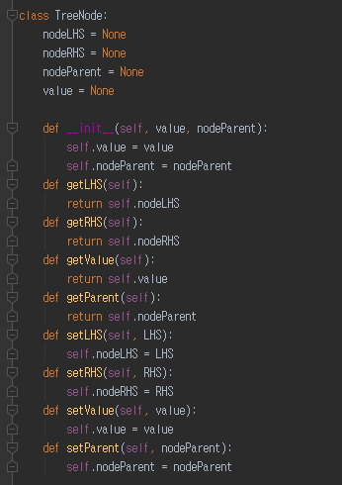
Implementation of tree node
Has three references
Left hand side (LHS)
Right hand side (RHS)
Its own value
Its parent node
Not implemented here, but
LHS stores
Values have lower than its own value
RHS stores
Values have higher than its own value
Just as we all know that the department stores do not have a restroom on the first floor
Other than four references,
Simple get/set methods
What are the get/set methods?
Coming from encapsulation
Four references
Notes:
To better understand the concept of a binary search tree, let’s consider its use in actual implementation.
First off, we need the nodes of a tree to construct a tree.
Suppose that there is a pointer directed to the reference of the parent in this node.
We would assume that we have the left and right here, along with the value pointing at values.
Thus, we will define a tree node with four references.
The four references point to the left-hand side (LHS), right hand side (RHS), its own value, and the parent.
Let’s say that the LHS always has a smaller value. RHS always indicates the node that points at a larger value.
Then, we would define a method that could “get” and “set” the references.
This example pretty much covers the simple definition of a tree node.

Slide 16
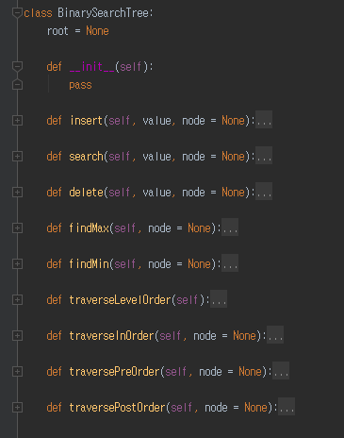
Implementation of BST
Tree instance
A (root)
B
C
D
E
F
BST handles the data stored through its root
Root has its own value
Tree instance access to the root
Only through the root, the tree instances access to the descendant nodes of the root
Notes:
Next, let’s move on and define the binary search tree.
A binary search tree primarily does not store the references of all the tree nodes. It just stores the one for root.
We can carry out operations such as insert, delete, and search by traversing from the root.
For this purpose, we’ve defined various operations including insert, search, delete, findMax, and findMin.
These are implemented by being filled up.
A tree only stores the information of the root.

Slide 17
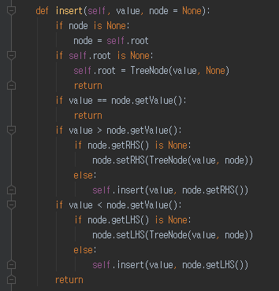
Insert operation of binary search tree
Insertion operation
Retrieve the current node value
If the value is equal to the value to insert
Return already there!
If the value is smaller than the value to insert
If there is a node in the right hand-side (RHS), then move to the RHS node (Recursion)
If there is no node in RHS, create a RHS node with the value to insert
If the value is larger than the value to insert
If there is a node in the left hand-side (LHS), then move to the LHS node (Recursion)
If there is no node in LHS, create a LHS node with the value to insert
Insert numbers: 3, 2, 0, 5, 7, 4…..
3
2
5
0
4
7
Notes:
Suppose that we are about to conduct “insert” into a binary search tree.
It is necessary for us to consider how to store values while complying with the rules of a binary search tree.
After defining the insert statement like this, you would notice that this is where recursion happens, which we’ve
learned before.
This is the place where you can accommodate the insert operation.
For a recursion to be operated, we need an escape routine.
We’ve found the escape routine here.
As you can see, we can carry out a return in this manner.
When we carry out the insert operation, we first receive a specific node.
If a node is not well-defined, we will get the root instead.
If the root is empty, we can just store a value in that place and return.
If we find that the value contained in the node is already present in the tree, we won’t do an overlapped insert.
Instead, we go for the “return”.
If the numeric value contained in the current node is larger than what will be stored, it should be stored in the LHS
of the node.
Therefore, we attempt to store the RHS of the node. If it’s empty, we can store the RHS in this node.
We can create a tree node and store a node pointing to the RHS in the node
If the node designated by the RHS is not empty, we have to determine which way to go from the node.
However, if we make an insert mode for the RHS’s node, it will be inserted at a reduced size.
In case the same operation is employed for the LHS, if the value is smaller than the one in the current node, it will
proceed with LHS in the same manner.
Let’s see how can we insert these numbers.
This is the process of inserting these numbers without a tree.
First, let’s say we are going to insert the number 3.
Right now, there is nothing in the tree.
Given that there is nothing in the node, we compare it with the root. As the root is left defined, we can define it to
hold the tree node of 3 and return.
So, 3 is stored according to this distinction.
Next, let’s say that we are storing 2.
Given the value of 2, the node will contain a garbage value to make the current node root.
The root isn’t empty, so we will skip the statement.
As the currently held value, 3 is not identical with the value that we intend to insert, 2. That means we can’t carry
out a “return”.
Comparing 2 and 3, as 3 is larger, it will enter the routine.
As the LHS is currently set to a garbage value, it will generate a new node with LHS set in the current node and
store the numeric value, which is 2.
It will do something like this.
Now let’s say we’re going to store 0.
The value turns into 0. The node has a garbage value, so the current node is the root.
As the root is neither empty nor identical, 3 and 0 are compared. The LHS is not empty as 0 is smaller than 3.
Thus, going through the recursion statement, it will produce 0. Then, the node of the LHS with 2 of the current
node that has the value of 3 will be inserted. Then, it will call the “insert” function.
Thus, the node is not a garbage value. 2 and 0 are not identical, so it will descend.
0 is smaller than 2.
As the LHS has a garbage value, we will store 0 there.
Thus, it will be actually stored with the statement. The “return” is actuated to ascend to this statement. Given that
the current node is 3, the function call will also be returned and terminated.
Here, the process of recursion stored 3, 2, and 0.
When 5 comes in, the value will be 5. This node is garbage, so we will skip it. And 3 and 5 are not identical and
5 is greater than 3, so it will be entered here.
As the RHS of the node 3 is empty right now, 5 will be stored with this statement.
Let’s try the same with 7.
As the node has a garbage value, 7, it moves to the lower level. Since it’s not equivalent to 3 again, it comes down.
As 7 is larger than 3 and the RHS is not empty, it will be applied to the recursion to be inserted for 5 here.
The current node will point at 5 with the value of 7. It will be inserted in a small-scale situation.
7 is not identical with 5. It’s larger than 5 with the occupied RHS, so 7 will be entered here for the return. It will
proceed with the recursion up to the return, resulting in 7 being stored.
What would happen to 4?
When 4 is entered, it will be compared to 3. Since 4 is larger than 3, the insert will be handed over to the RHS,
before being compare to 5. As 4 is smaller than 5 with an empty LHS, it will be stored in the LHS. Consequently,
these numeric values will be stored in this binary search tree.

Slide 18
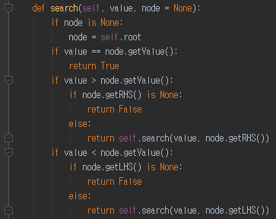
Search operation of binary search tree
Search operation
Retrieve the current node value
If the value is equal to the value to search
Return TRUE
If the value is smaller than the value to search
If there is a node in the right hand-side (RHS), then move to the RHS node (Recursion)
If there is no node in RHS, return FALSE
If the value is larger than the value to search
If there is a node in the left hand-side (LHS), then move to the LHS node (Recursion)
If there is no node in LHS, return FALSE
Find 4 in the BST
3
2
5
0
4
7

Slide 19
Delete operation of binary search tree (1)
First, you need to find the node to delete through recursions
Three deletion cases
Case 1: deleting a node with no children
Just remove the node by modifying its parent
Case 2: deleting a node with one child
Replace the node with the child
Case 3: deleting a node with two children
Find either
A maximum in the LHS or A minimum in the RHS
Substitute the node to delete with the found value
Delete the found node in the LHS or the RHS
3
2
5
0
4
7
Case 1: Just Remove ‘0’
3
2
5
0
4
7
Case 2: Replace ‘2’ with ‘0’

Slide 20
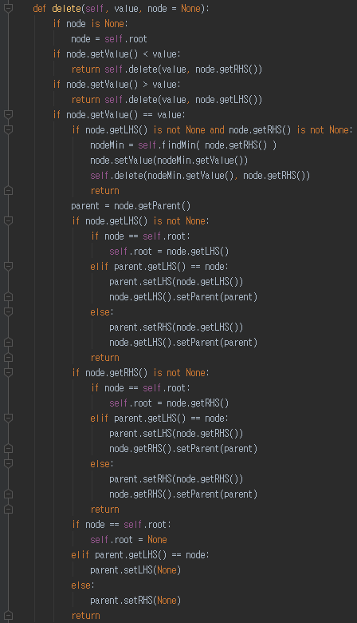
Delete operation of binary search tree (2)
4
2
2
5
0
5
0
7
4
7
Delete ‘4’ in RHS
Delete ‘2’ in LHS
4
2
2
5
2
5
0
4
7
3
0
4
7
Replace ‘3’ with ‘2’
Replace ‘3’ with ‘4’
2
5
0
4
7
Case 3: Replace ‘3’ with ‘X’

Slide 21
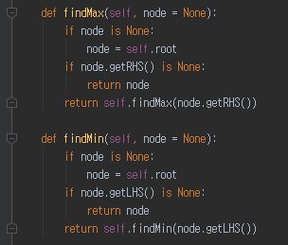
Minimum and maximum in binary search tree
Finding minimum in a BST
Just keep following the LHS
Because this will always result in the smaller value than the value of the current node
When you can’t any LHS, then the value of the current node is the smallest
Finding maximum in a BST
Just keep following the RHS
Because this will always result in the larger value than the value of the current node
When you can’t any RHS, then the value of the current node is the largest
3
Finding Min.
Finding Max.
2
5
0
4
7

Slide 22
Tree traversing
Tree
Complicated than a list
Multiple ways to show the entire dataset
If it were a list
Just show the values from the beginning to the end
Since this is a BST
You have to choose what to show at a time
The value in LHS
The value in RHS
The value that you have
Hence there are multiple traversing approaches
Inserting 3, 2, 0, 5, 7, 4, 6, 1, 9, 8
LHS
RHS
Level 1
3
Level 2
2
5
Level 3
0
4
7
Level 4
1
6
9
Level 5
8

Slide 23
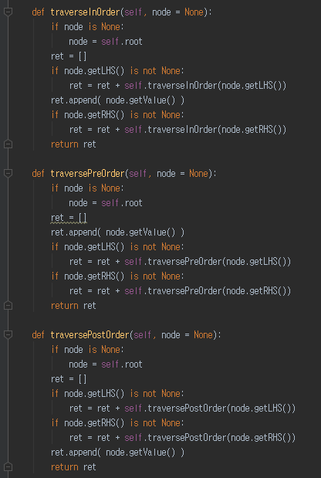
Depth first traverse
Pre-order traverse
Order: Current, LHS, RHS in Recursion
3, 2, 0, 1, 5, 4, 7, 6, 9, 8
In-order traverse
Order: LHS, Current, RHS in Recursion
0, 1, 2, 3, 4, 5, 6, 7, 8, 9
Post-order traverse
Order: LHS, RHS, Current in Recursion
1, 0, 2, 4, 6, 8, 9, 7, 5, 3
3
2
5
0
4
7
1
6
9
8

Slide 24
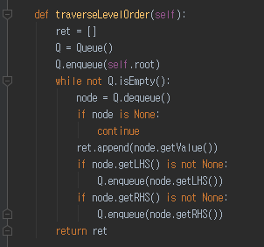
Breadth first traverse
3
Queue-based level-order traverse
3, 2, 5, 0, 4, 7, 1, 6, 9, 8
Enqueue the root
While until queue is empty
Current = Dequeue one element
Print current
If Current’s LHS exist
Enqueue current.LHS
If Current’s RHS exist
Enqueue current.RHS
2
5
0
4
7
1
6
9
Current | Queue
 | 3
3 | 2, 5
2 | 5, 0
5 | 0, 4, 7
0 | 4, 7, 1
4 | 7, 1
7 | 1, 6, 9
1 | 6, 9
6 | 9
9 | 8
8
8

Slide 25
Performance of binary search tree
3
Coming from divide and conquer
 | Linked List | BST in Average | BST in Worst Case
Search | O(n) | O(log n) | O(n)
Insert after search | O(1) | O(1) | O(1)
Delete after search | O(1) | O(1) | O(1)
Traverse | O(n) | O(n) | O(n)
2
5
0
4
7
BST in Average
Insert 3, 2, 0, 5, 4, 7
0
2
3
4
BST in Worst Case
5
Insert 0, 2, 3, 4, 5, 7
7

Slide 26
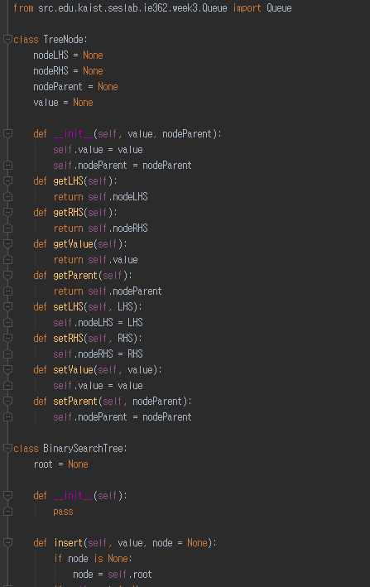
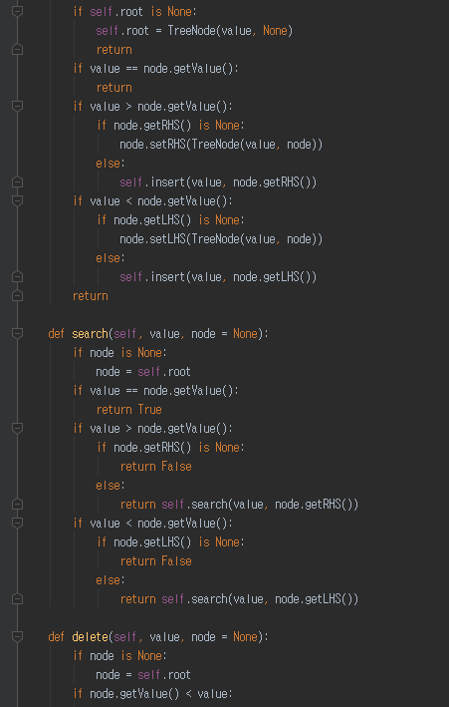
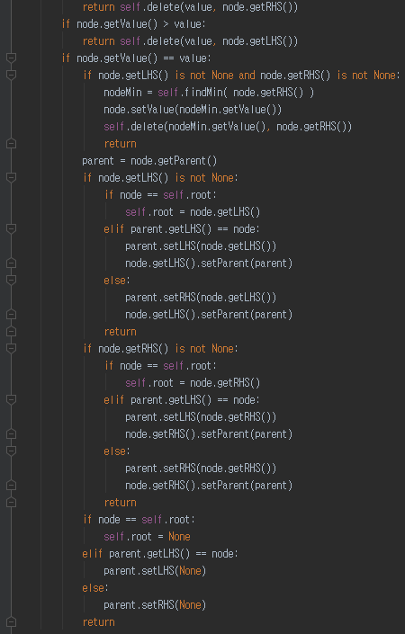
Complete Implementation of BST (1)

Slide 27
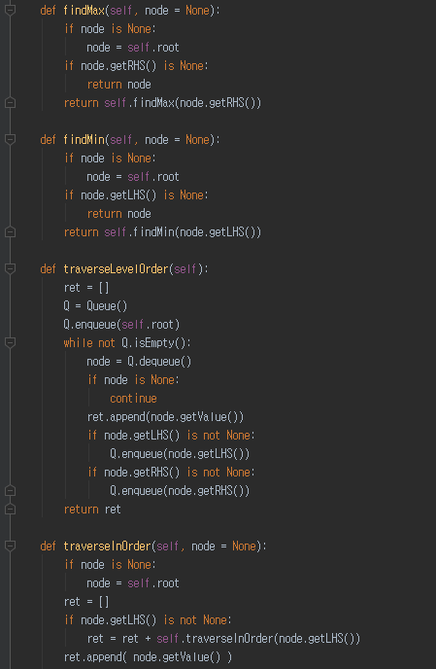
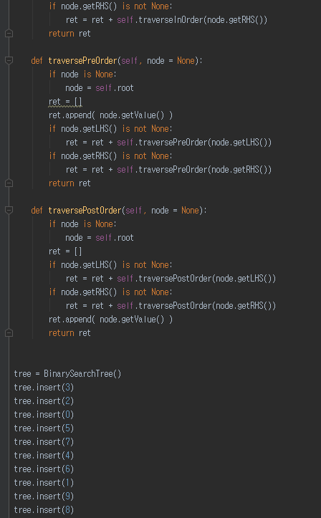
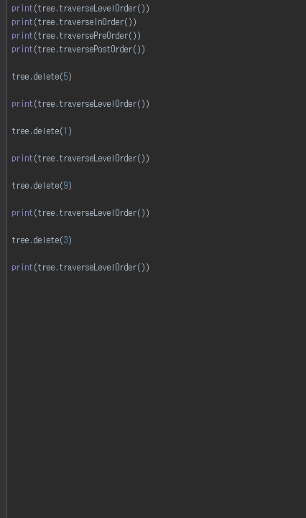
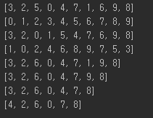
Complete Implementation of BST (2)

